Slide 1
Dynamic Market Pricing in Autonomous Car Allocation
Ido Kessler, Jonathan Somer, Itay Itzhak

Slide 2




Dynamic Market Pricing in Autonomous Car Allocation

Slide 3
Motivation
How is this relevant to nowdays?

Slide 4
Autonomous Vehicles Defined
Vehicle that get from one point to another point without human interaction.
Implement a number of well placed sensors that detect different things such as other vehicles, people, traffic lights, and movement of other vehicles.

Slide 5
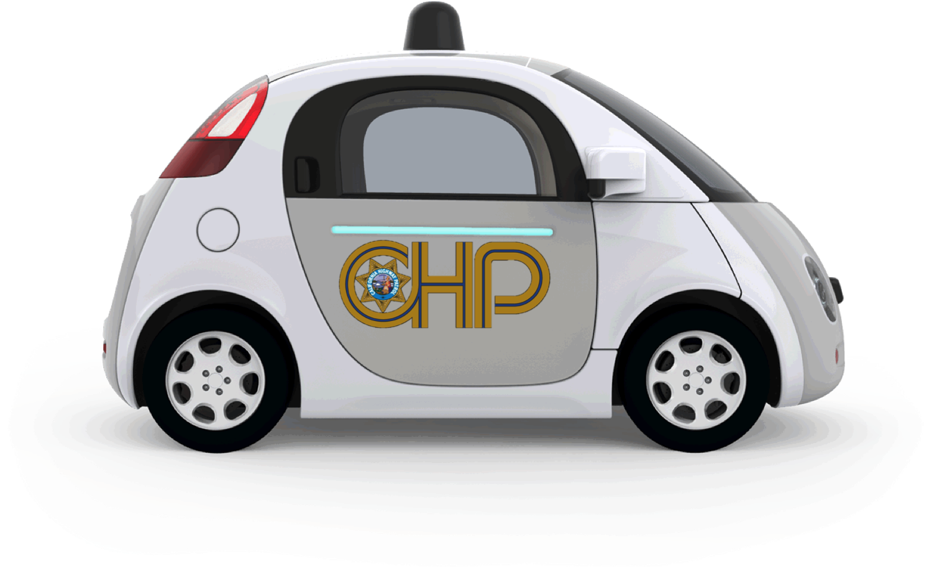
Google Waymo
Google’s autonomous driving project.
In testing since 2009.
“In May 2018, Waymo announced that it plans to allow everyone in Phoenix, Arizona to request a driverless ride before the end of year”.

Slide 6
Other Autonomous Car Projects
Mercedes
Toyota
Apple
Nissan
Audi
Tesla

Slide 7
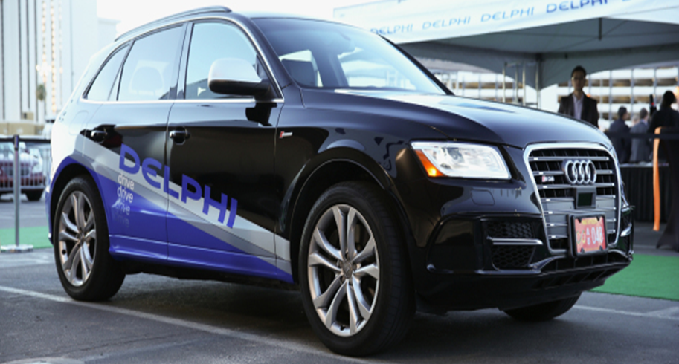
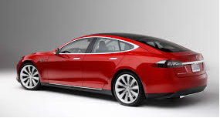
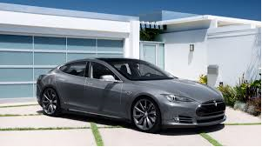
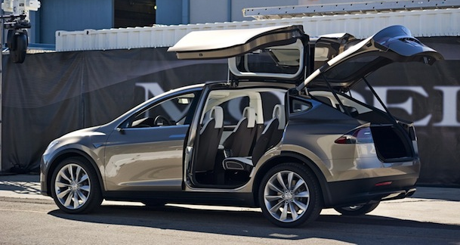

Slide 8

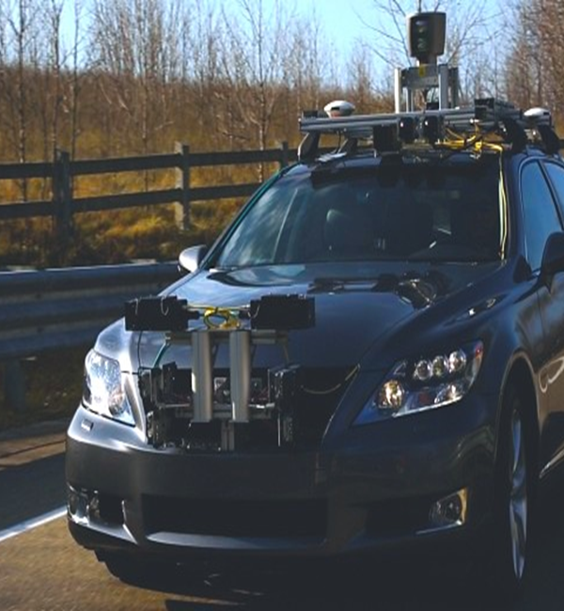
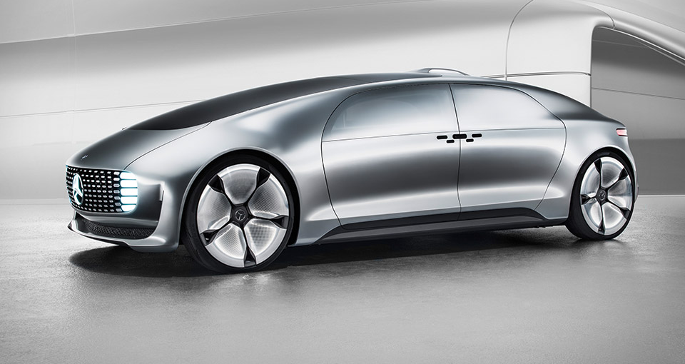

Slide 9
Autonomous Car Business Model
Problems arise when providing autonomous cars as just another consumer product:
Park while driving
Stand still autonomous cars
Instead the most discussed business model is “autonomous cabs”
A set of autonomous cars that you can order like a taxi in apps like “Gett” or “Uber”

Slide 10
Motivation
Modelling the car allocation problem as a auction problem with dynamic pricing enables us to present three new features for the problem:
Social welfare
Valuation function
Dynamic pricing
Reusing the knowledge we acquire in the course might provide result that maximize the social welfare of the autonomous cabs, and by doing that might actually get this service to be way more accessible for the general public.

Slide 11
The Formal Model

Slide 12

The Formal Model
World: $W$
Agents: $N$
Items: $M=\{(S→T, Arrival To Target Time)|S,T∈W\}$
Assume the cabs arrival can be computed backwards (like in Waze)
Valuation function: $v_{i}:M→ℝ$
Unlike auction like models, this model come with $\left({\left|W\right|}^{2}−\left|W\right|\right)∗\frac{{\left|T\right|}^{2}−|T|}{2}$. To simplify it will shall assume that the valuation function is defined as such:
Lets say agent $i$ wish to do path $S→T$, and to arrive in time $[t_{1},t_{2}]$.
Then the valuation is:
$v_{i}\left(x\right)=\left\{\begin{aligned} &f(x), x_{path}=S→T, x_{Arrival Time}∈\left[t_{1},t_{2}\right] \\ &0, otherwise\end{aligned}\right.$
This will allow us to look only on a subset of the items in each time.
Another problem is that taking one items might effect multiple other items (Taking a cab to somewhere might get it further enough so other ride will not be available then)

Slide 13

Possible Other Formal Model
World: $W$
Agents: $N$
Items: $M=\{(S→T, StartTime,Arrival To Target Time)|S,T∈W\}$
Valuation function: $v_{i}:M→ℝ$
The difference is that this time we allow people to ride together – which might minimize their cost, but might get them going in a longer way.

Slide 14
First Results
HashCode

Slide 15

First results
We took a known dataset to work on:
Google Hash Code Data Sets:
Assume all rides are planned.
Every agent has a $(S→T,[StartTime, EndTime])$
$f\left(x\right)=\left\{\begin{aligned} &|S−T|+bonus, x=startTime \\ &|S−T|, otherwise\end{aligned}\right.$

Slide 16
First results – First try

Slide 17
First results – Second try

Slide 18
Future and Wanted Results

Slide 19
Future and Wanted Results

